Slide 1

LANs
addressing, ARP
Ethernet
switches
VLANs
a day in the life of a web request

Slide 2
MAC addresses
32-bit IP address:
network-layer address for interface
used for layer 3 (network layer) forwarding
e.g.: 128.119.40.136
MAC (or LAN or physical or Ethernet) address:
function: used “locally” to get frame from one interface to another physically-connected interface (same subnet, in IP-addressing sense)
48-bit MAC address (for most LANs) burned in NIC ROM, also sometimes software settable
e.g.: 1A-2F-BB-76-09-AD
hexadecimal (base 16) notation
(each “numeral” represents 4 bits)

Slide 3

MAC addresses
each interface on LAN
has unique 48-bit MAC address
has a locally unique 32-bit IP address (as we’ve seen)
137.196.7.78
1A-2F-BB-76-09-AD
LAN
(wired or wireless)
137.196.7/24
71-65-F7-2B-08-53
58-23-D7-FA-20-B0
137.196.7.23
137.196.7.14
0C-C4-11-6F-E3-98
137.196.7.88

Slide 4
MAC addresses
MAC address allocation administered by IEEE
manufacturer buys portion of MAC address space (to assure uniqueness)
analogy:
MAC address: like Social Security Number
IP address: like postal address
MAC flat address: portability
can move interface from one LAN to another
recall IP address not portable: depends on IP subnet to which node is attached

Slide 5
ARP: address resolution protocol
Question: how to determine interface’s MAC address, knowing its IP address?
ARP table: each IP node (host, router) on LAN has table
ARP
137.196.7.78
IP/MAC address mappings for some LAN nodes:
< IP address; MAC address; TTL>
TTL (Time To Live): time after which address mapping will be forgotten (typically 20 min)
1A-2F-BB-76-09-AD
ARP
ARP
LAN
71-65-F7-2B-08-53
58-23-D7-FA-20-B0
137.196.7.23
137.196.7.14
ARP
0C-C4-11-6F-E3-98
137.196.7.88

Slide 6
ARP protocol in action
example: A wants to send datagram to B
B’s MAC address not in A’s ARP table, so A uses ARP to find B’s MAC address
A broadcasts ARP query, containing B's IP addr
destination MAC address = FF-FF-FF-FF-FF-FF
all nodes on LAN receive ARP query
1
Ethernet frame (sent to FF-FF-FF-FF-FF-FF)
C
Source MAC: 71-65-F7-2B-08-53
Source IP: 137.196.7.23
Target IP address: 137.196.7.14
…
ARP table in A
IP addr
MAC addr
TTL
TTL
A
B
1
71-65-F7-2B-08-53
58-23-D7-FA-20-B0
137.196.7.23
137.196.7.14
D

Slide 7
ARP protocol in action
example: A wants to send datagram to B
B’s MAC address not in A’s ARP table, so A uses ARP to find B’s MAC address
ARP message into Ethernet frame (sent to 71-65-F7-2B-08-53)
C
Target IP address: 137.196.7.14
Target MAC address:
58-23-D7-FA-20-B0
…
ARP table in A
IP addr
MAC addr
TTL
TTL
A
B
2
71-65-F7-2B-08-53
58-23-D7-FA-20-B0
137.196.7.23
137.196.7.14
2
B replies to A with ARP response, giving its MAC address
D

Slide 8
ARP protocol in action
example: A wants to send datagram to B
B’s MAC address not in A’s ARP table, so A uses ARP to find B’s MAC address
C
ARP table in A
IP addr
MAC addr
TTL
TTL
A
B
137.196.
7.14
58-23-D7-FA-20-B0
500
71-65-F7-2B-08-53
58-23-D7-FA-20-B0
137.196.7.23
137.196.7.14
3
A receives B’s reply, adds B entry into its local ARP table
D

Slide 9

Routing to another subnet: addressing
walkthrough: sending a datagram from A to B via R
focus on addressing – at IP (datagram) and MAC layer (frame) levels
assume that:
A knows B’s IP address
A knows IP address of first hop router, R (how?)
A knows R’s MAC address (how?)
A
R
B
111.111.111.111
74-29-9C-E8-FF-55
222.222.222.222
49-BD-D2-C7-56-2A
222.222.222.220
1A-23-F9-CD-06-9B
111.111.111.112
111.111.111.110
CC-49-DE-D0-AB-7D
E6-E9-00-17-BB-4B
222.222.222.221
88-B2-2F-54-1A-0F

Slide 10
Routing to another subnet: addressing
A creates IP datagram with IP source A, destination B
A creates link-layer frame containing A-to-B IP datagram
R's MAC address is frame’s destination
MAC src: 74-29-9C-E8-FF-55
MAC dest: E6-E9-00-17-BB-4B
IP
Eth
Phy
IP src: 111.111.111.111
IP dest: 222.222.222.222
A
R
B
111.111.111.111
74-29-9C-E8-FF-55
222.222.222.222
49-BD-D2-C7-56-2A
222.222.222.220
1A-23-F9-CD-06-9B
111.111.111.112
111.111.111.110
CC-49-DE-D0-AB-7D
E6-E9-00-17-BB-4B
222.222.222.221
88-B2-2F-54-1A-0F

Slide 11
Routing to another subnet: addressing
frame sent from A to R
frame received at R, datagram removed, passed up to IP
MAC src: 74-29-9C-E8-FF-55
MAC dest: E6-E9-00-17-BB-4B
IP src: 111.111.111.111
IP dest: 222.222.222.222
IP
Eth
Phy
IP src: 111.111.111.111
IP dest: 222.222.222.222
IP
Eth
Phy
A
R
B
111.111.111.111
74-29-9C-E8-FF-55
222.222.222.222
49-BD-D2-C7-56-2A
222.222.222.220
1A-23-F9-CD-06-9B
111.111.111.112
111.111.111.110
CC-49-DE-D0-AB-7D
E6-E9-00-17-BB-4B
222.222.222.221
88-B2-2F-54-1A-0F

Slide 12
Routing to another subnet: addressing
R determines outgoing interface, passes datagram with IP source A, destination B to link layer
R creates link-layer frame containing A-to-B IP datagram. Frame destination address: B's MAC address
MAC src: 1A-23-F9-CD-06-9B
MAC dest: 49-BD-D2-C7-56-2A
IP
Eth
Phy
IP src: 111.111.111.111
IP dest: 222.222.222.222
A
R
B
111.111.111.111
74-29-9C-E8-FF-55
222.222.222.222
49-BD-D2-C7-56-2A
222.222.222.220
1A-23-F9-CD-06-9B
111.111.111.112
111.111.111.110
CC-49-DE-D0-AB-7D
E6-E9-00-17-BB-4B
222.222.222.221
88-B2-2F-54-1A-0F

Slide 13
Routing to another subnet: addressing
R determines outgoing interface, passes datagram with IP source A, destination B to link layer
R creates link-layer frame containing A-to-B IP datagram. Frame destination address: B's MAC address
MAC src: 1A-23-F9-CD-06-9B
MAC dest: 49-BD-D2-C7-56-2A
transmits link-layer frame
IP
Eth
Phy
IP
Eth
Phy
IP src: 111.111.111.111
IP dest: 222.222.222.222
A
R
B
111.111.111.111
74-29-9C-E8-FF-55
222.222.222.222
49-BD-D2-C7-56-2A
222.222.222.220
1A-23-F9-CD-06-9B
111.111.111.112
111.111.111.110
CC-49-DE-D0-AB-7D
E6-E9-00-17-BB-4B
222.222.222.221
88-B2-2F-54-1A-0F

Slide 14
Routing to another subnet: addressing
B receives frame, extracts IP datagram destination B
B passes datagram up protocol stack to IP
IP src: 111.111.111.111
IP dest: 222.222.222.222
IP
Eth
Phy
IP
Eth
Phy
A
R
B
111.111.111.111
74-29-9C-E8-FF-55
222.222.222.222
49-BD-D2-C7-56-2A
222.222.222.220
1A-23-F9-CD-06-9B
111.111.111.112
111.111.111.110
CC-49-DE-D0-AB-7D
E6-E9-00-17-BB-4B
222.222.222.221
88-B2-2F-54-1A-0F

Slide 15
Link layer, LANs: roadmap
introduction
error detection, correction
multiple access protocols
LANs
addressing, ARP
Ethernet
switches
VLANs
link virtualization: MPLS
data center networking
a day in the life of a web request

Slide 16
Link layer, LANs: roadmap
LANs
addressing, ARP
Ethernet
switches
a day in the life of a web request

Slide 17
Ethernet switch
Switch is a link-layer device: takes an active role
store, forward Ethernet frames
examine incoming frame’s MAC address, selectively forward frame to one-or-more outgoing links when frame is to be forwarded on segment, uses CSMA/CD to access segment
transparent: hosts unaware of presence of switches
plug-and-play, self-learning
switches do not need to be configured

Slide 18
Switch: multiple simultaneous transmissions
hosts have dedicated, direct connection to switch
switches buffer packets
Ethernet protocol used on each incoming link, so:
no collisions; full duplex
each link is its own collision domain
A
C’
B
1
2
6
3
5
4
B’
C
A’
switching: A-to-A’ and B-to-B’ can transmit simultaneously, without collisions
switch with six interfaces (1,2,3,4,5,6)

Slide 19

Switch: multiple simultaneous transmissions
hosts have dedicated, direct connection to switch
switches buffer packets
Ethernet protocol used on each incoming link, so:
no collisions; full duplex
each link is its own collision domain
A
C’
B
1
2
6
3
5
4
B’
C
A’
switching: A-to-A’ and B-to-B’ can transmit simultaneously, without collisions
but A-to-A’ and C to A’ can not happen simultaneously
switch with six interfaces (1,2,3,4,5,6)

Slide 20
Switch forwarding table
Q: how does switch know A’ reachable via interface 4, B’ reachable via interface 5?
A
C’
B
A: each switch has a switch table, each entry:
(MAC address of host, interface to reach host, time stamp)
looks like a routing table!
1
2
6
3
5
4
B’
C
A’
Q: how are entries created, maintained in switch table?
something like a routing protocol?

Slide 21
Switch: self-learning
Source: A
switch learns which hosts can be reached through which interfaces
Dest: A’
A A’
A
C’
B
when frame received, switch “learns” location of sender: incoming LAN segment
1
2
6
3
5
4
records sender/location pair in switch table
B’
C
A’
Switch table
(initially empty)
MAC addr interface TTL
A
1
60

Slide 22
Switch: frame filtering/forwarding
when frame received at switch:
1. record incoming link, MAC address of sending host
2. index switch table using MAC destination address
3. if entry found for destination then {
if destination on segment from which frame arrived then drop frame
else forward frame on interface indicated by entry
}
else flood /* forward on all interfaces except arriving interface */

Slide 23
Self-learning, forwarding: example
Source: A
Dest: A’
frame destination, A’, location unknown:
A A’
flood
A
C’
B
destination A location known:
selectively send
on just one link
1
2
6
A A’
A A’
A A’
A A’
A A’
3
5
4
B’
C
A’ A
A’
MAC addr interface TTL
A
1
60
switch table
(initially empty)
A’
4
60

Slide 24


Interconnecting switches
self-learning switches can be connected together:
S₄
S₁
S₃
A
S₂
F
I
B
C
D
E
G
H
Q: sending from A to G - how does S₁ know to forward frame destined to G via S₄ and S₃?
A: self learning! (works exactly the same as in single-switch case!)

Slide 25
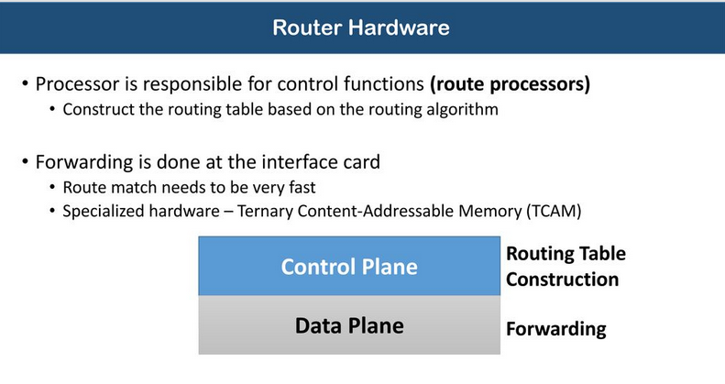
ROUTERS AND FIB

Slide 26
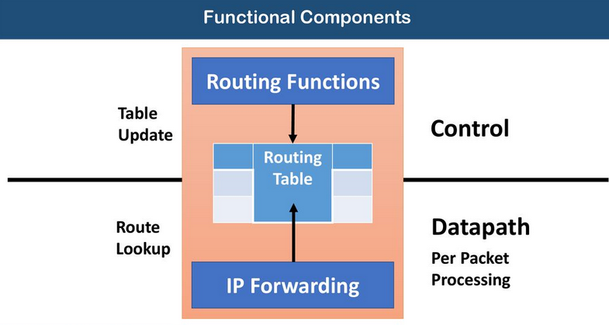

Slide 27
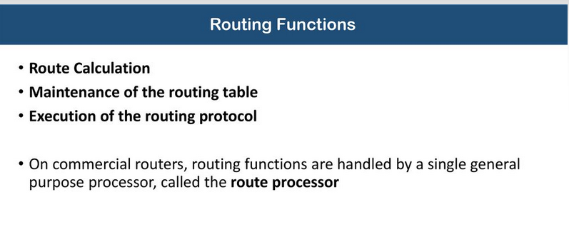

Slide 28
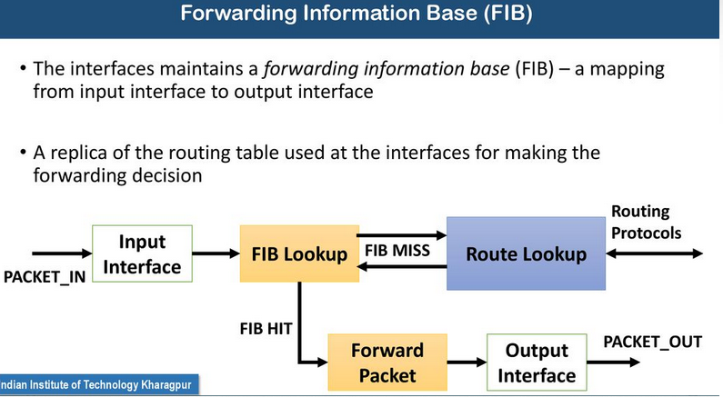

Slide 29
